Slide 1
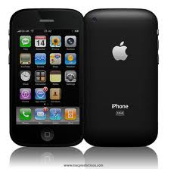
iPHONE
distribution
© 2009 Telefónica Investigación y Desarrollo, S.A. Unipersonal

Slide 6
Creating your distribution application

Slide 7

Obtaining your Certificate

Slide 8
Assigning Devices

Slide 9
Creating your App IDs

Slide 10
Creating Provisioning Profiles

Slide 11

© 2009 Telefónica Investigación y Desarrollo, S.A. Unipersonal

